Slide 1
W4111 – Introduction to Databases Section 002, Spring 2025 Lecture 2: Foundation – ER, Relational, SQL (2)
COMSW4111_002_2025_2 - Foundation – ER, Relational, SQL (2) © Donald F. Ferguson, 2025

Slide 2
Contents

Slide 3
Notes and Content
Status updates, homework 1B
ER Model/Modeling:
Additional concepts: associative entity, weak entity, multi-valued attributes
Translating an ER diagram into SQL – some examples.
Relational algebra
Additional operators: union, intersect, set difference, renaming
Some examples
SQL
Integrity constraints
Some data types
WITH, common table expressions
Operators: Union, intersect, set difference, renaming
A first look at SUBQUERY
Project concepts: (Web) applications, REST, data engineering

Slide 4
Status Update, HW 1B

Slide 5
Status Updates, Homework 1B
I was sick, down and missing in action for several days. I am catching up on Ed Discussions, email, etc.
I have asked the TAs to grade
HW0 by 09-FEB
HW1A by 15-FEB
Homework 1B
The calendar shows homework 2 coming out this weekend.
I want to stick to the calendar to enable student planning/scheduling ==> I am cancelling homework 1B.

Slide 6
ER Model/ER Modeling

Slide 7
Relationship Sets
A relationship is an association among several entities
Example: 44553 (Peltier) advisor 22222 (Einstein) student entity relationship set instructor entity
A relationship set is a mathematical relation among n ≥ 2 entities, each taken from entity sets
{(e₁, e₂, … e_{n}) | e₁ ∈ E₁, e₂ ∈ E₂, …, e_{n} ∈ E_{n}} where (e₁, e₂, …, e_{n}) is a relationship
Example:
(44553, 22222) ∈ advisor

Slide 8
Relationship Sets (Cont.)
Example: we define the relationship set advisor to denote the associations between students and the instructors who act as their advisors.
Pictorially, we draw a line between related entities.
The fact that Katz advises 2 students is important ➔ The instructor – advises -> student relationship is one-to-many ➔ The foreign key must be from student to instructor.

Slide 9
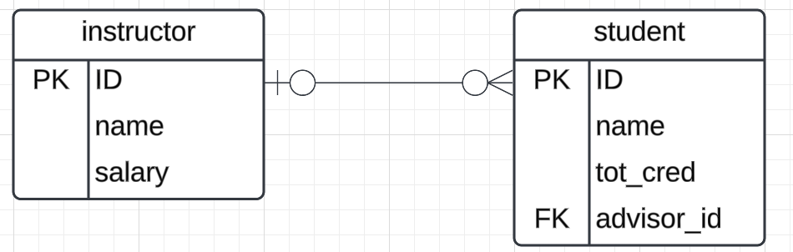
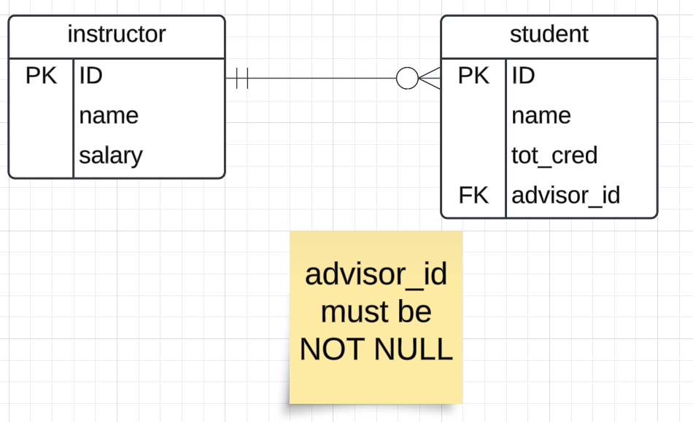
Representing Relationship Sets via ER Diagrams
Diamonds represent relationship sets.

Slide 10
Many-to-Many
Let’s consider a modification and assume that
A student may have more than one advisor
An instructor may advise several students ➔
The relationship is many-to-many ➔
We cannot implement this in SQL using foreign keys ➔
We need an associative entity.
“An associative entity is a term used in relational and entity–relationship theory. A relational database requires the implementation of a base relation (or base table) to resolve many-to-many relationships. A base relation representing this kind of entity is called, informally, an associative table.” (https://en.wikipedia.org/wiki/Associative_entity)

Slide 11
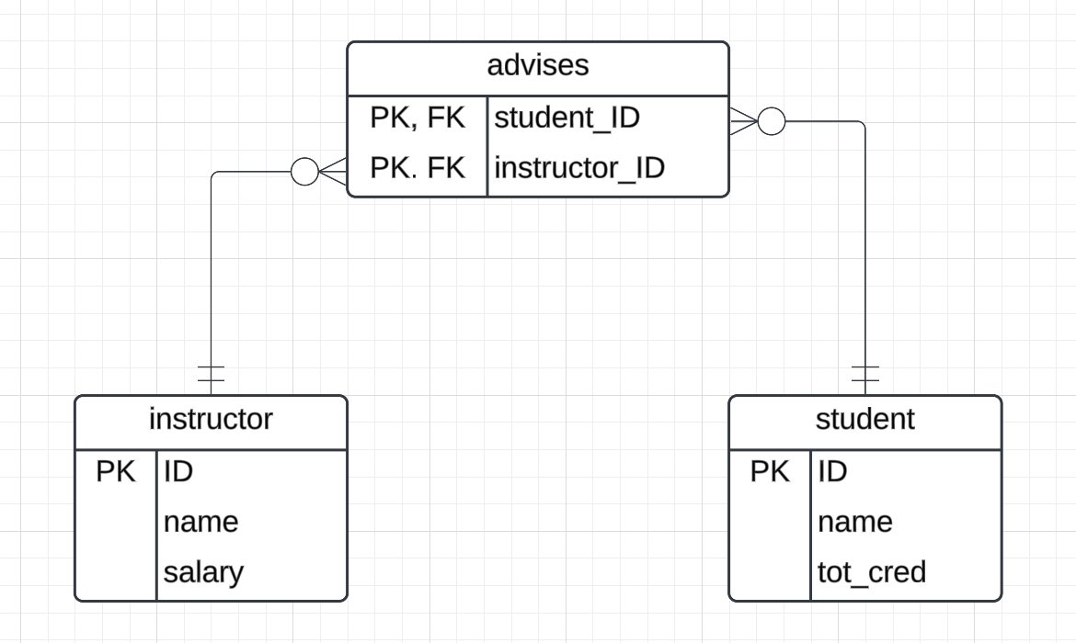
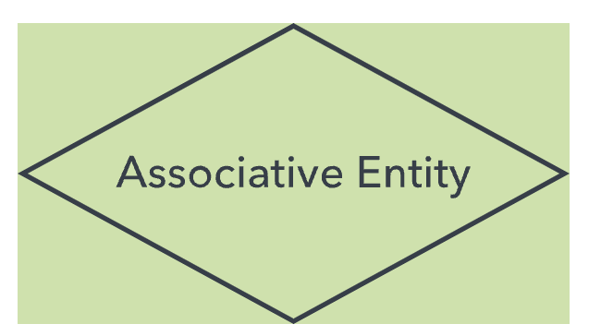
Associative Entity
This symbol is quasi-standard, but then again almost everything in ER diagrams is quasi-standard. ER diagram rules – “Tis a custom more honored in the breach than the observance”

Slide 12
Relationship Sets (Cont.)
An attribute can also be associated with a relationship set.
For instance, the advisor relationship set between entity sets instructor and student may have the attribute date which tracks when the student started being associated with the advisor

Slide 13
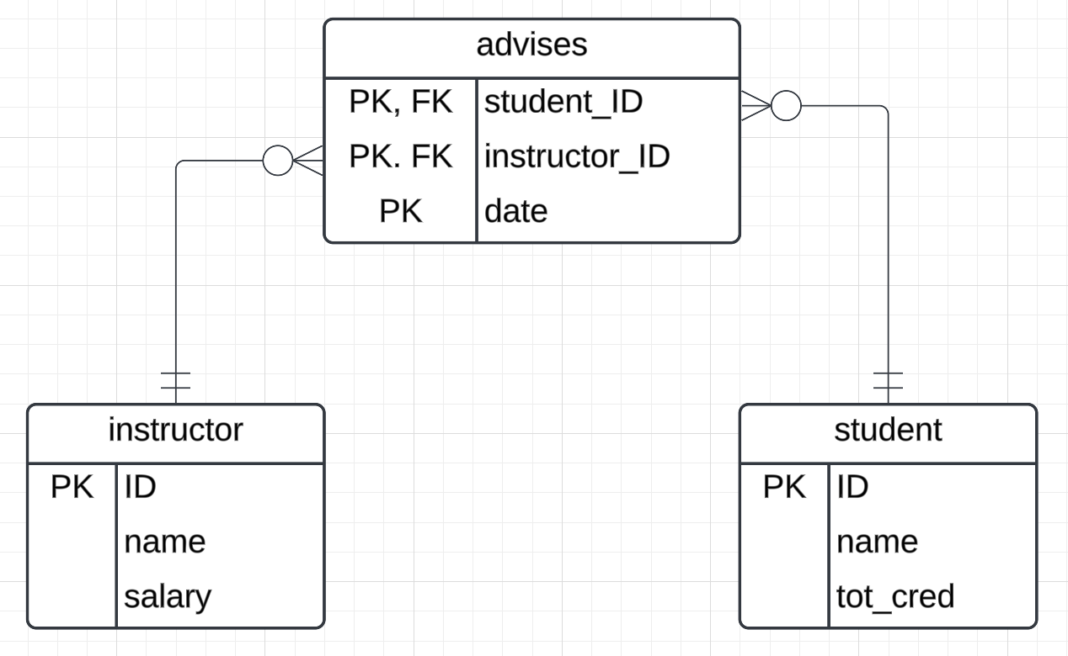
Relationship Sets with Attributes

Slide 14
Associative Entity
When translating an ER diagram into SQL, there are two reasons to use an associative entity.
The relationship is many-to-many OR
The relationship has properties/attributes.
Despite being a “relational database,” SQL only has entities.
This is not true for some NoSQL databases. We will see that relationship (edge) with properties is a first-class concept in graph databases (https://en.wikipedia.org/wiki/Graph_database).

Slide 15
Weak Entity Sets
Consider a section entity, which is uniquely identified by a course_id, semester, year, and sec_id.
Clearly, section entities are related to course entities. Suppose we create a relationship set sec_course between entity sets section and course.
Note that the information in sec_course is redundant, since section already has an attribute course_id, which identifies the course with which the section is related.
One option to deal with this redundancy is to get rid of the relationship sec_course; however, by doing so the relationship between section and course becomes implicit in an attribute, which is not desirable.

Slide 16
Weak Entity Sets (Cont.)
An alternative way to deal with this redundancy is to not store the attribute course_id in the section entity and to only store the remaining attributes section_id, year, and semester.
However, the entity set section then does not have enough attributes to identify a particular section entity uniquely
To deal with this problem, we treat the relationship sec_course as a special relationship that provides extra information, in this case, the course_id, required to identify section entities uniquely.
A weak entity set is one whose existence is dependent on another entity, called its identifying entity
Instead of associating a primary key with a weak entity, we use the identifying entity, along with extra attributes called discriminator to uniquely identify a weak entity.

Slide 17
Weak Entity Sets (Cont.)
An entity set that is not a weak entity set is termed a strong entity set.
Every weak entity must be associated with an identifying entity; that is, the weak entity set is said to be existence dependent on the identifying entity set.
The identifying entity set is said to own the weak entity set that it identifies.
The relationship associating the weak entity set with the identifying entity set is called the identifying relationship.
Note that the relational schema we eventually create from the entity set section does have the attribute course_id, for reasons that will become clear later, even though we have dropped the attribute course_id from the entity set section.

Slide 18
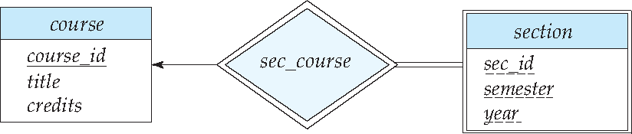
Expressing Weak Entity Sets
In E-R diagrams, a weak entity set is depicted via a double rectangle.
We underline the discriminator of a weak entity set with a dashed line.
The relationship set connecting the weak entity set to the identifying strong entity set is depicted by a double diamond.
Primary key for section – (course_id, sec_id, semester, year)

Slide 19
Weak Entity Set
This is a somewhat obscure and pedantic concept. But, it may come up in interviews, discussions, etc.
In Crow’s Foot notation, you can infer weak entities if an entity has an attribute that is part of a primary key and a foreign key.
Summary:
I will ask you questions about the weak entity concept.
You normally due not worry about this term when modeling and converting models into SQL DDL.
You implement the concept with primary key, foreign key constraints.

Slide 20
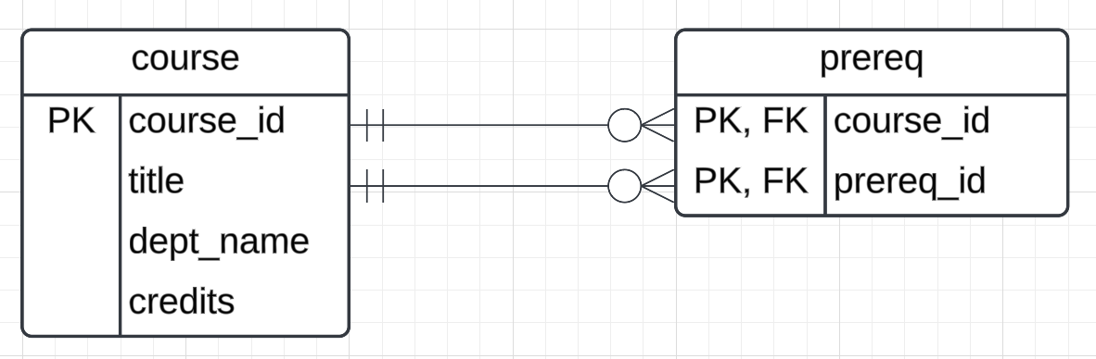
Roles
Entity sets of a relationship need not be distinct
Each occurrence of an entity set plays a “role” in the relationship
The labels “course_id” and “prereq_id” are called roles.
The associative entity is only needed because course – prereq -> course is many-to-many.
If it each course had at most one prereq, you could use a foreign key.

Slide 21
Complex Attributes
Attribute types:
Simple and composite attributes.
Single-valued and multivalued attributes
Example: multivalued attribute: phone_numbers
Derived attributes
Can be computed from other attributes
Example: age, given date_of_birth
Domain – the set of permitted values for each attribute

Slide 22
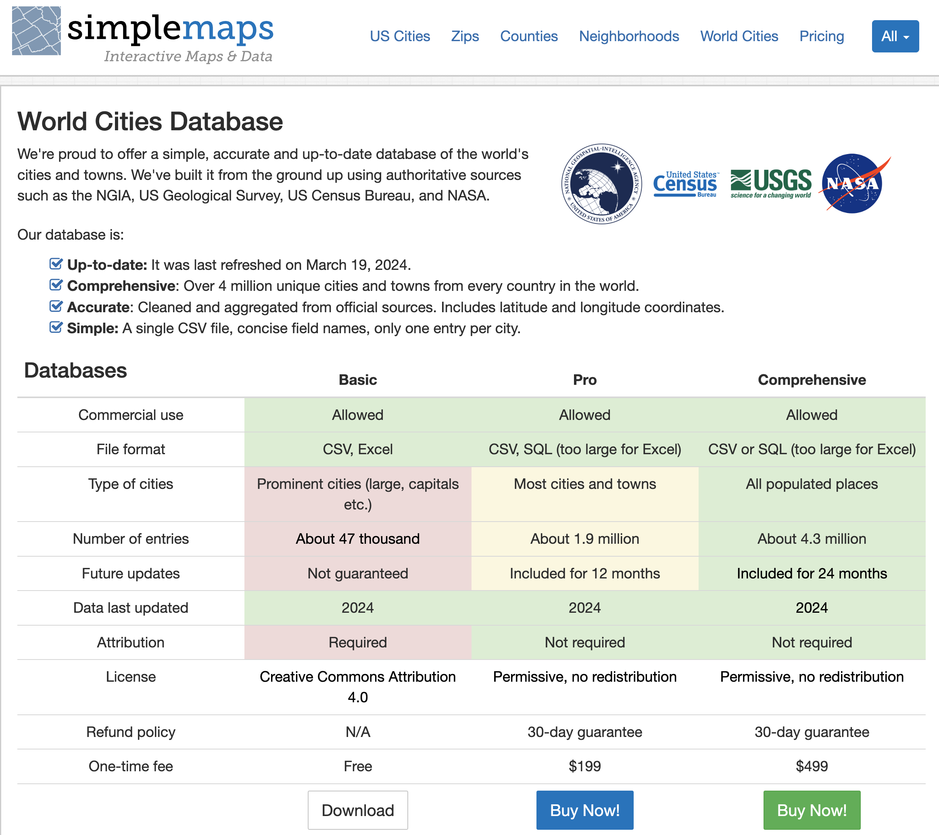
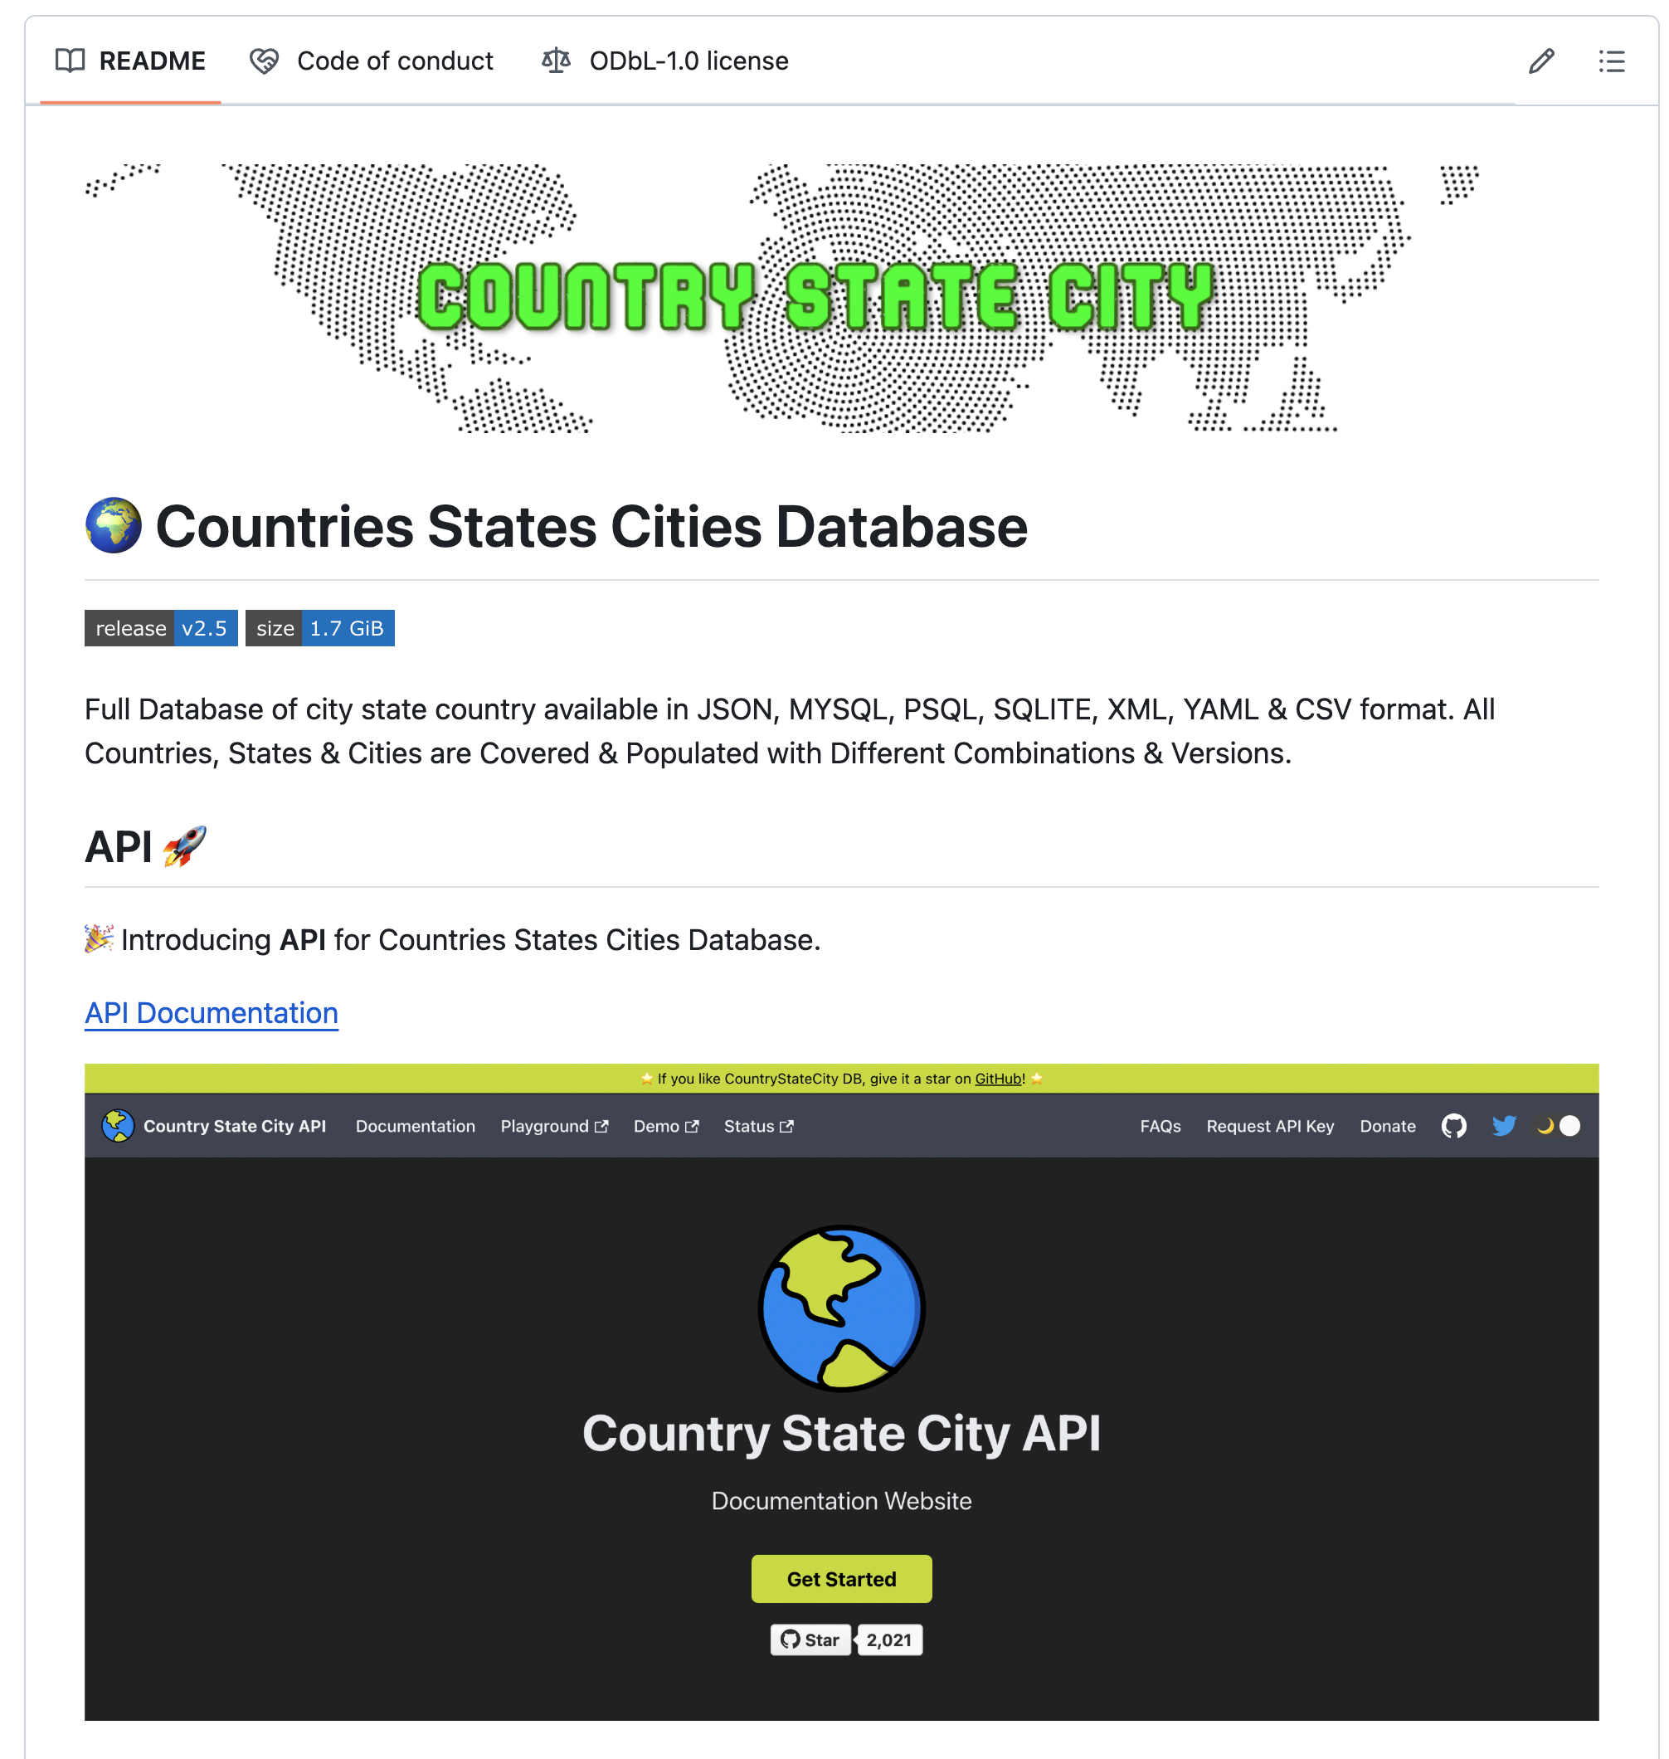
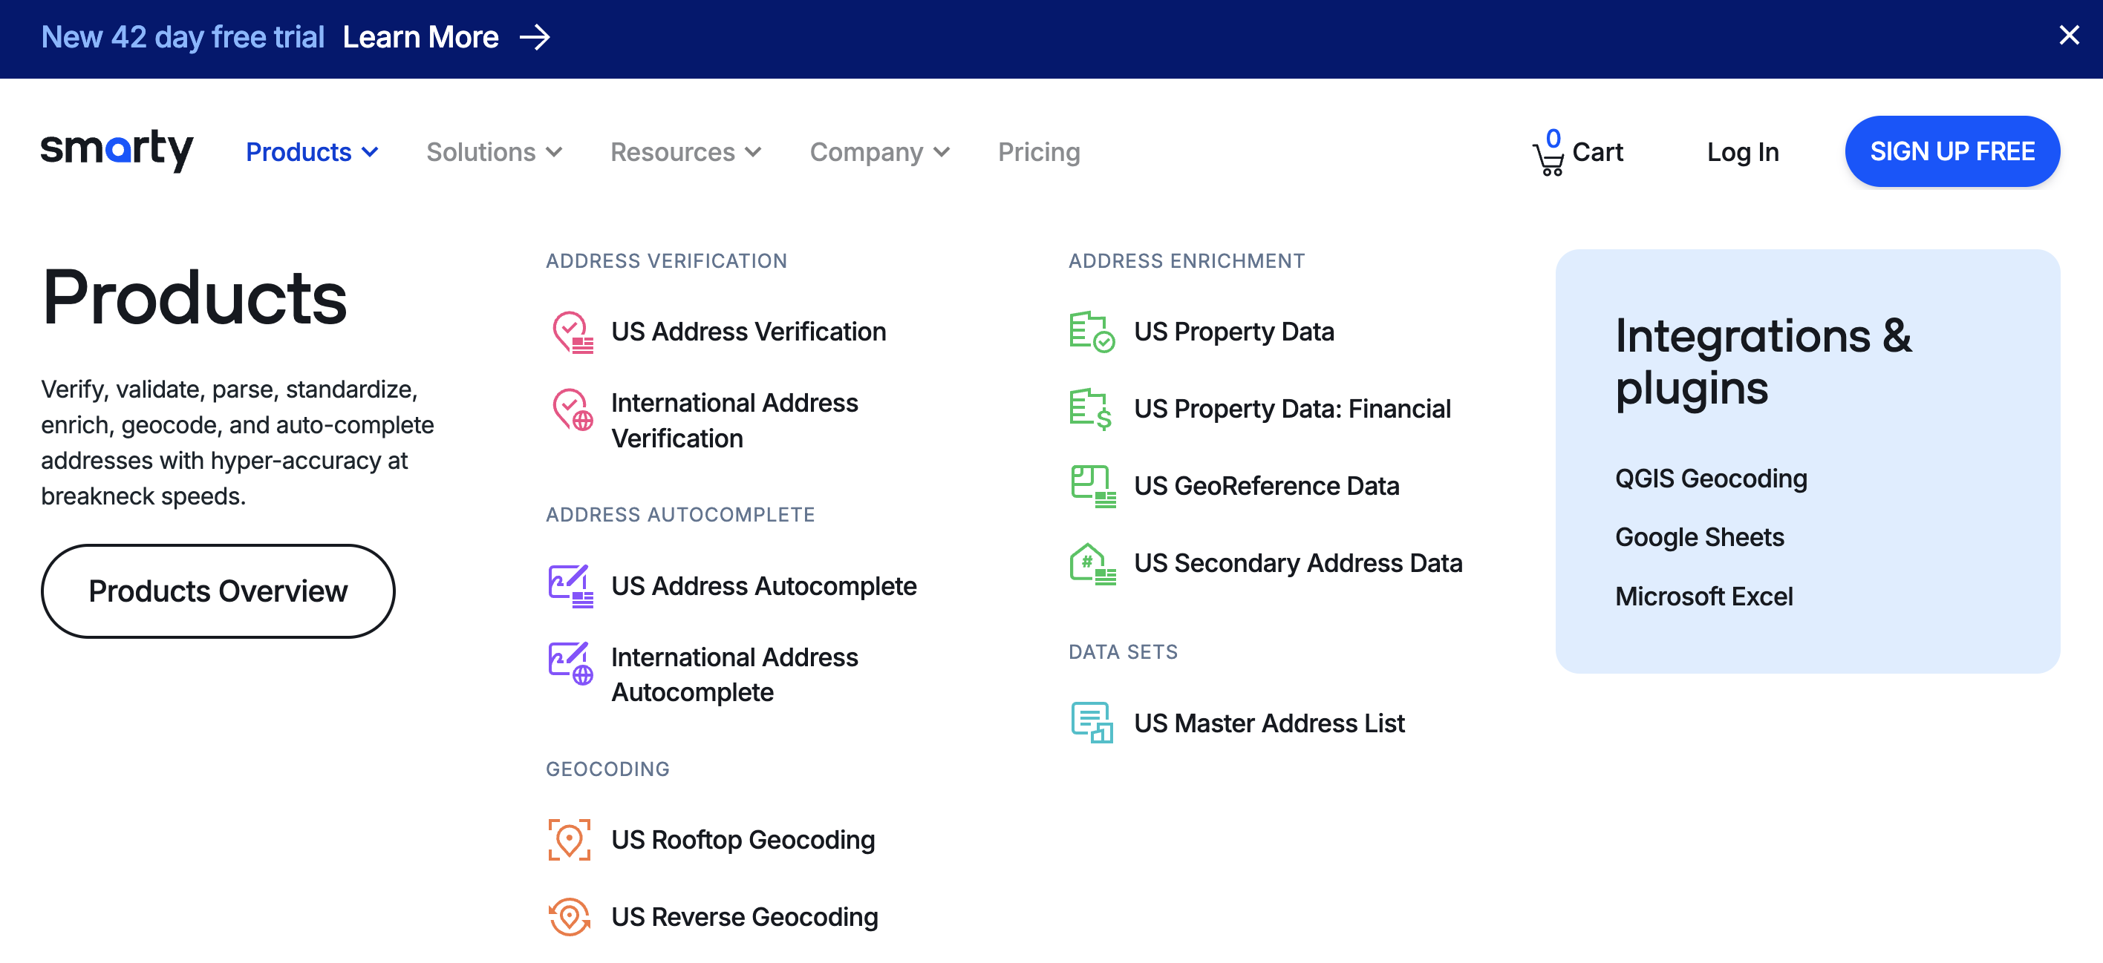
Data Cleanup/Validation

Slide 23
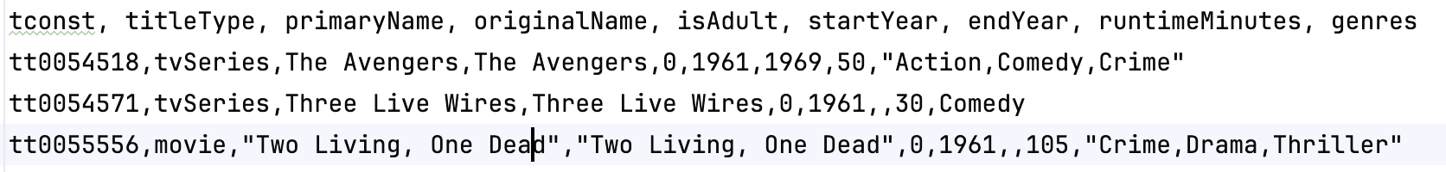
Multivalued Attributes
The relational model and SQL require (strongly encourage) attribute domains to be atomic.
“Every domain must contain atomic values(smallest indivisible units) which means composite and multi-valued attributes are not allowed.” (https://www.geeksforgeeks.org/constraints-on-relational-database-model/#)
This is sometimes known as “First Normal Form.” We will cover normalization later in the semester.
When loading data, e.g. the IMDB data, you often encounter multi-valued attributes.
How do we handle in relational/SQL? (Switch to notebook)

Slide 24
Relational Algebra

Slide 25
Union Operation
The union operation allows us to combine two relations
Notation: r ∪ s
For r ∪ s to be valid.
1. r, s must have the same arity (same number of attributes)
2. The attribute domains must be compatible (example: 2nd
column of r deals with the same type of values as does the 2nd column of s)
Example: to find all courses taught in the Fall 2017 semester, or in the Spring 2018 semester, or in both ∏_{course_id} (σ _{semester=“Fall” Λ year=2017} (section)) ∪ ∏_{course_id} (σ _{semester=“Spring” Λ year=2018} (section))
When the “arity” is not quite right, you can shape with project.

Slide 26
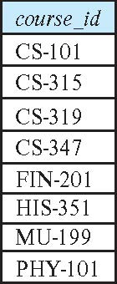
Union Operation (Cont.)
Result of: ∏_{course_id} (σ _{semester=“Fall” Λ year=2017} (section)) ∪ ∏_{course_id} (σ _{semester=“Spring” Λ year=2018} (section))

Slide 27
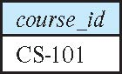
Set-Intersection Operation
The set-intersection operation allows us to find tuples that are in both the input relations.
Notation: r ∩ s
Assume:
r, s have the same arity
attributes of r and s are compatible
Example: Find the set of all courses taught in both the Fall 2017 and the Spring 2018 semesters.
∏_{course_id} (σ _{semester=“Fall” Λ year=2017} (section)) ∩ ∏_{course_id} (σ _{semester=“Spring” Λ year=2018} (section))
Result

Slide 28
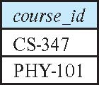
Set Difference Operation
The set-difference operation allows us to find tuples that are in one relation but are not in another.
Notation r – s
Set differences must be taken between compatible relations.
r and s must have the same arity
attribute domains of r and s must be compatible
Example: to find all courses taught in the Fall 2017 semester, but not in the Spring 2018 semester ∏_{course_id} (σ _{semester=“Fall” Λ year=2017} (section)) − ∏_{course_id} (σ _{semester=“Spring” Λ year=2018} (section))

Slide 29
Simple Examples
σ dept_name='Comp. Sci.’ (instructor ∪ student) produces a weird answer because the union does not make any sense.
There is the correct number of columns and the types match.
different, the domain are different.
There are times when the tables have different numbers of columns, the column order is different, or the types are incompatible.
You can fix the arity problem using a project.
A somewhat artificial example is:
σ dept_name='Comp. Sci.'
((π ID, name, dept_name, salary, tot_cred←0 (instructor))
∪
(π ID, name, dept_name, salary←0, tot_cred (student)))
Instead of using “0,” I should have set the not applicable values to NULL but the RelaX calculator did not like that.

Slide 30
The Assignment Operation
It is convenient at times to write a relational-algebra expression by assigning parts of it to temporary relation variables.
The assignment operation is denoted by ← and works like assignment in a programming language.
Example: Find all instructor in the “Physics” and Music department. Physics ← σ _{dept_name=“Physics”} (instructor)
Music ← σ _{dept_name=“Music”} (instructor)
Physics ∪ Music
With the assignment operation, a query can be written as a sequential program consisting of a series of assignments followed by an expression whose value is displayed as the result of the query.

Slide 31
The Rename Operation
The results of relational-algebra expressions do not have a name that we can use to refer to them. The rename operator, ρ , is provided for that purpose
The expression:
ρ_{x} (E)
returns the result of expression E under the name x
Another form of the rename operation:
ρ_{x(A1,A2, .. An)} (E)

Slide 32
Putting Some Pieces Together
Consider a course and its prereqs. (course ⨝ prereq) ⨝ course_id=prereq_id course
There are a couple of problems with this query.
Does course.course_id refer to the first course or the prereq course?
We would wind up with a couple of columns with the same name.
Something like this “fixes” the problem. (course ⨝ prereq) ⨝ the_prereq.course_id=prereq_id (ρ the_prereq(course))
Renaming columns would also work and probably improve the answer.
π course_id ← course.course_id, course_title←course.title,
prereq_id←the_prereq.course_id, prereq_title←the_prereq.title
(
(course ⨝ prereq) ⨝ the_prereq.course_id=prereq_id (ρ the_prereq(course))
)

Slide 33
SQL

Slide 34
SQL Parts
DML -- provides the ability to query information from the database and to insert tuples into, delete tuples from, and modify tuples in the database.
integrity – the DDL includes commands for specifying integrity constraints.
View definition -- The DDL includes commands for defining views.
Transaction control –includes commands for specifying the beginning and ending of transactions.
Embedded SQL and dynamic SQL -- define how SQL statements can be embedded within general-purpose programming languages.
Authorization – includes commands for specifying access rights to relations and views.

Slide 35
Data Definition Language
The SQL data-definition language (DDL) allows the specification of information about relations, including:
The schema for each relation.
The type of values associated with each attribute.
The Integrity constraints
The set of indices to be maintained for each relation.
Security and authorization information for each relation.
The physical storage structure of each relation on disk.

Slide 36
Create Table Construct
An SQL relation is defined using the create table command:
create table r
(A₁ D₁, A₂ D₂, ..., A_{n} D_{n}, (integrity-constraint₁), ..., (integrity-constraint_{k}))
r is the name of the relation
each A_{i} is an attribute name in the schema of relation r
D_{i} is the data type of values in the domain of attribute A_{i}
Example:
create table instructor ( ID char(5), name varchar(20), dept_name varchar(20), salary numeric(8,2))

Slide 37
Integrity Constraints in Create Table
Types of integrity constraints
primary key (A₁, ..., A_{n} )
foreign key (A_{m}, ..., A_{n} ) references r
not null
SQL prevents any update to the database that violates an integrity constraint.
Example:
create table instructor ( ID char(5), name varchar(20) not null, dept_name varchar(20), salary numeric(8,2), primary key (ID), foreign key (dept_name) references department);

Slide 38
Integrity Constraints
Integrity constraints guard against accidental damage to the database, by ensuring that authorized changes to the database do not result in a loss of data consistency.
A checking account must have a balance greater than $10,000.00
A salary of a bank employee must be at least $4.00 an hour
A customer must have a (non-null) phone number
Integrity constraints as an integral part of DDL and implemented “in the database” is one of the great strengths of SQL.
Dozens of applications and thousands of users may access and update data. Relying on correctly documenting and implementing in many places is error prone.
Business changes that result in changed constraints creates a complex documentation and application modification problem.

Slide 39
Constraints on a Single Relation
not null
primary key
unique
check (P), where P is a predicate

Slide 40
Not Null Constraints
not null
Declare name and budget to be not null
name varchar(20) not null budget numeric(12,2) not null

Slide 41
Unique Constraints
unique ( A₁, A₂, …, A_{m})
The unique specification states that the attributes A₁, A₂, …, A_{m} form a candidate key.
Candidate keys are permitted to be null (in contrast to primary keys).
Show example in notebook.

Slide 42
The check clause
The check (P) clause specifies a predicate P that must be satisfied by every tuple in a relation.
Example: ensure that semester is one of fall, winter, spring or summer
create table section
(course_id varchar (8),
sec_id varchar (8),
semester varchar (6),
year numeric (4,0),
building varchar (15),
room_number varchar (7),
time slot id varchar (4),
primary key (course_id, sec_id, semester, year),
check (semester in ('Fall', 'Winter', 'Spring', 'Summer')))
There is a better, or different, way to handle the semester “constraint.”
Switch to notebook.

Slide 43
Referential Integrity
Ensures that a value that appears in one relation for a given set of attributes also appears for a certain set of attributes in another relation.
Example: If “Biology” is a department name appearing in one of the tuples in the instructor relation, then there exists a tuple in the department relation for “Biology”.
Let A be a set of attributes. Let R and S be two relations that contain attributes A and where A is the primary key of S. A is said to be a foreign key of R if for any values of A appearing in R these values also appear in S.

Slide 44
Referential Integrity (Cont.)
Foreign keys can be specified as part of the SQL create table statement
foreign key (dept_name) references department
By default, a foreign key references the primary-key attributes of the referenced table.
SQL allows a list of attributes of the referenced relation to be specified explicitly.
foreign key (dept_name) references department (dept_name)

Slide 45
Cascading Actions in Referential Integrity
When a referential-integrity constraint is violated, the normal procedure is to reject the action that caused the violation.
An alternative, in case of delete or update is to cascade
create table course ( (… dept_name varchar(20), foreign key (dept_name) references department on delete cascade on update cascade, . . .)
Instead of cascade we can use :
set null,
set default
I tend to avoid cascading, but that is just my style. I think delete and update should be explicit.
Cascade does make more sense for Weak Entities.

Slide 46
Complex Check Conditions
The predicate in the check clause can be an arbitrary predicate that can include a subquery.
check (time_slot_id in (select time_slot_id from time_slot))
The check condition states that the time_slot_id in each tuple in the section relation is actually the identifier of a time slot in the time_slot relation.
The condition has to be checked not only when a tuple is inserted or modified in section , but also when the relation time_slot changes

Slide 47
Built-in Data Types in SQL
date: Dates, containing a (4 digit) year, month and date
Example: date '2005-7-27'
time: Time of day, in hours, minutes and seconds.
Example: time '09:00:30' time '09:00:30.75'
timestamp: date plus time of day
Example: timestamp '2005-7-27 09:00:30.75'
interval: period of time
Example: interval '1' day
Subtracting a date/time/timestamp value from another gives an interval value
Interval values can be added to date/time/timestamp values

Slide 48
Large-Object Types
Large objects (photos, videos, CAD files, etc.) are stored as a large object:
blob: binary large object -- object is a large collection of uninterpreted binary data (whose interpretation is left to an application outside of the database system)
clob: character large object -- object is a large collection of character data
When a query returns a large object, a pointer is returned rather than the large object itself.
Historically,
BLOBs were for data like images, scans, … …
CLOBs were for things like documents.
By and large with the emergence of the web and object/block storage, databases simply store URLs to the “large object.”

Slide 49
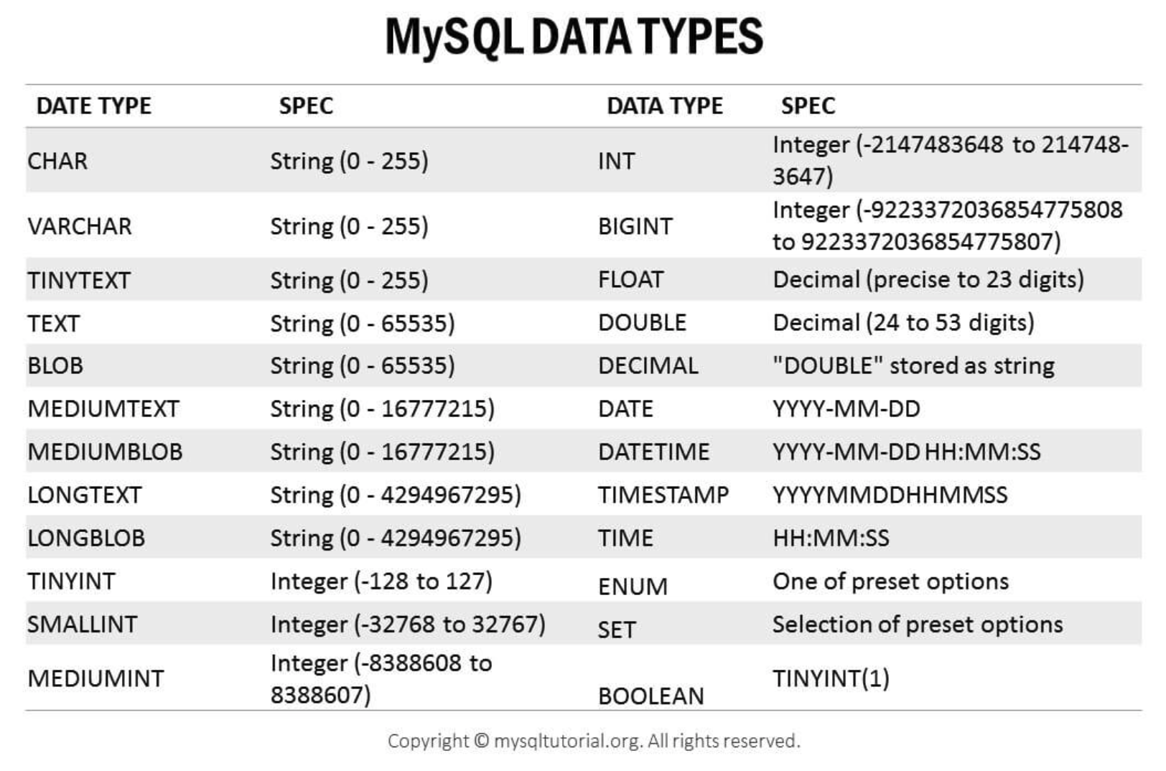
MySQL Data Types (Partial)

Slide 50
Summary
All SQL implementations in a common core set of data types.
All SQL implementations/products introduce their own additional and extended data types.
The benefits of the types are:
Implementing constraints and integrity on setting data values.
There are often special functions that understand the domain.
The easiest example to help understanding is time/date.
Let’s see some examples in the notebook.
When you have homework assignments, you will have to look at the documentation or Google or ChatGPT to know if there is an appropriate data type. Practice is the only way you learn. On exams, I will provide a cheat sheet.

Slide 51
With Clause
The with clause provides a way of defining a temporary relation whose definition is available only to the query in which the with clause occurs.
Find all departments with the maximum budget with max_budget (value) as (select max(budget) from department) select department.name from department, max_budget where department.budget = max_budget.value;

Slide 52
Complex Queries using With Clause
Find all departments where the total salary is greater than the average of the total salary at all departments
with dept _total (dept_name, value) as
(select dept_name, sum(salary)
from instructor
group by dept_name),
dept_total_avg(value) as
(select avg(value)
from dept_total)
select dept_name
from dept_total, dept_total_avg
where dept_total.value > dept_total_avg.value;
These are also called common table expressions.
These are very, very helpful when writing complex queries with many clauses.
“Slow is smooth. Smooth is fast.”
“Break it down Barney Style.”
Let’s look at a complex example in the notebook.

Slide 53
Set Operations
Find courses that ran in Fall 2017 or in Spring 2018
(select course_id from section where sem = 'Fall' and year = 2017) union (select course_id from section where sem = 'Spring' and year = 2018)
Find courses that ran in Fall 2017 and in Spring 2018
(select course_id from section where sem = 'Fall' and year = 2017) intersect (select course_id from section where sem = 'Spring' and year = 2018)
Find courses that ran in Fall 2017 but not in Spring 2018
(select course_id from section where sem = 'Fall' and year = 2017) except (select course_id from section where sem = 'Spring' and year = 2018)

Slide 54
Set Operations (Cont.)
Set operations union, intersect, and except
Each of the above operations automatically eliminates duplicates
To retain all duplicates use the
union all,
intersect all
except all.

Slide 55
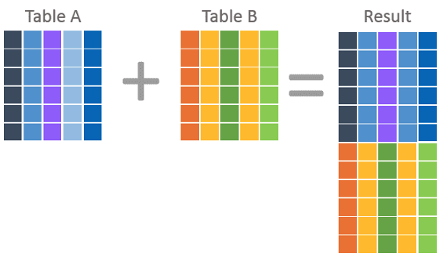
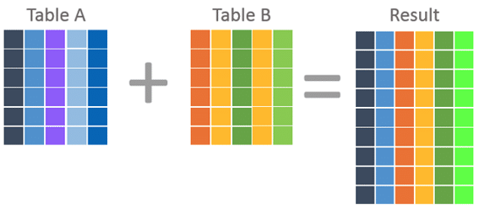
JOIN and UNION
There are basically two approaches to putting tables together.
UNION kind of “stacks” the tables.
JOIN kind of ”puts them side by side.”
We will see that there are more sophisticated patterns, including subqueries for combining tables.

Slide 56
Nested Subqueries
SQL provides a mechanism for the nesting of subqueries. A subquery is a select-from-where expression that is nested within another query.
The nesting can be done in the following SQL query select A₁, A₂, ..., A_{n} from r₁, r₂, ..., r_{m} where P
as follows:
From clause: r_{i} can be replaced by any valid subquery
Where clause: P can be replaced with an expression of the form:
B <operation> (subquery)
B is an attribute and <operation> to be defined later.
Select clause:
A_{i} can be replaced be a subquery that generates a single value.
Note:
This is a little cryptic.
I think I know what they mean.
There are some operations we will see later in the material, e.g IN, EXISTS, ... ...

Slide 57
Subqueries in the Form Clause
SQL allows a subquery expression to be used in the from clause
Find the average instructors’ salaries of those departments where the average salary is greater than $42,000.”
select dept_name, avg_salary from ( select dept_name, avg (salary) as avg_salary from instructor group by dept_name) where avg_salary > 42000;
Note that we do not need to use the having clause
Another way to write above query
select dept_name, avg_salary from ( select dept_name, avg (salary) from instructor group by dept_name)
as dept_avg (dept_name, avg_salary)
where avg_salary > 42000;

Slide 58
Scalar Subquery
Scalar subquery is one which is used where a single value is expected
List all departments along with the number of instructors in each department
select dept_name, ( select count(*) from instructor where department.dept_name = instructor.dept_name) as num_instructors from department;
Runtime error if subquery returns more than one result tuple

Slide 59
Let’s See Some Examples
Go to the notebook.

Slide 60
Applications, REST, Data Engineering Project

Slide 61
REST and Web Applications

Slide 62
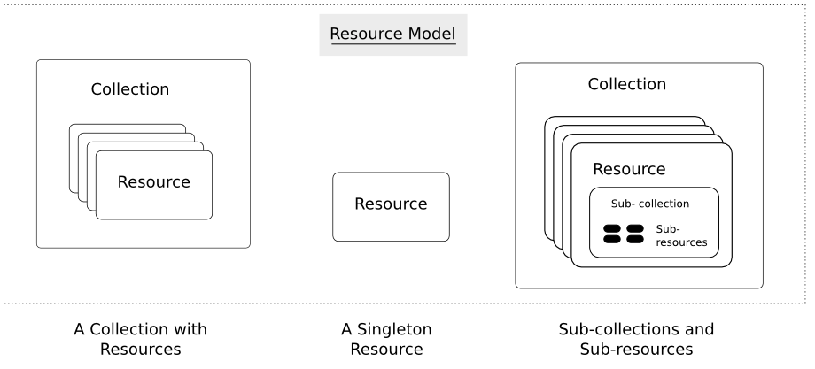
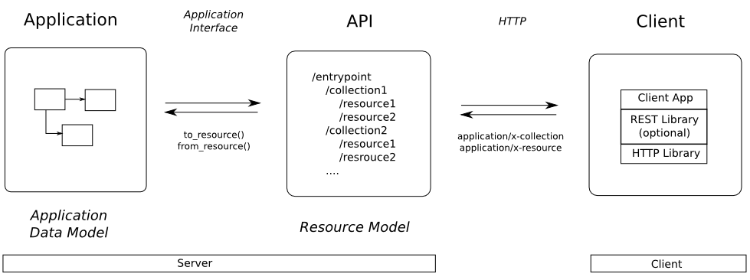
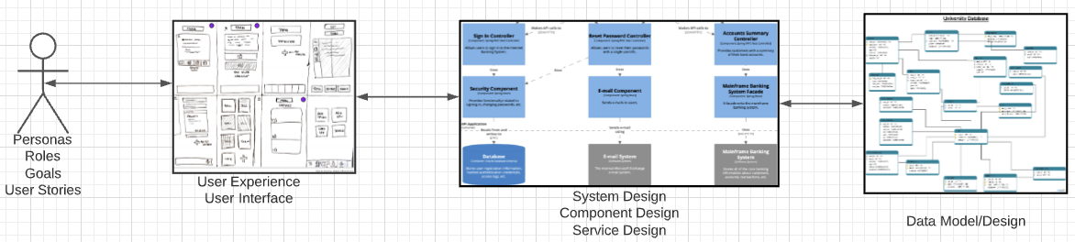
Web Application Problem Statement
We must build a system that supports create, retrieve, update and delete for IMDB and Game of Thrones Datasets.
This requires implementing create, retrieve, update and delete (CRUD) for resources.
We will design, develop, test and deploy the system iteratively and continuously.
There are four core domains.
https://restful-api-design.readthedocs.io/en/latest/resources.html
In this course,
We focus on the data dimension.
We will get some insight into the other dimensions.

Slide 63
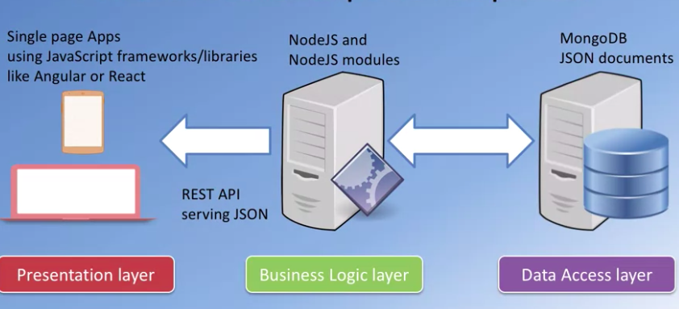
Interactive/Operational
“A full stack web developer is a person who can develop both client and server software. In addition to mastering HTML and CSS, he/she also knows how to:
Program a browser (like using JavaScript, jQuery, Angular, or Vue)
Program a server (like using PHP, ASP, Python, or Node)
Program a database (like using SQL, SQLite, or MongoDB)”
https://www.w3schools.com/whatis/whatis_fullstack.asp
We will do a simple full stack app.
Three databases:
MySQL
MongoDB
Neo4j
The application tier will be Python and FastAPI.
The web UI will be Angular.
The primary focus is the data layer and application layer that access it.
I will provide a simple UI and template.

Slide 64
Data Modeling Concepts and REST
Almost any data model has the same core concepts:
Types and instances:
Entity Type: A definition of a type of thing with properties and relationships.
Entity Instance: A specific instantiation of the Entity Type
Entity Set Instance: An Entity Type that:
Has properties and relationships like any entity, but ...
Has at least one special relationship – contains.
Operations, minimally CRUD, that manipulate entity types and instances:
Create
Retrieve
Update
Delete
Reference/Identify/... ...
Host/database/table/pk

Slide 65
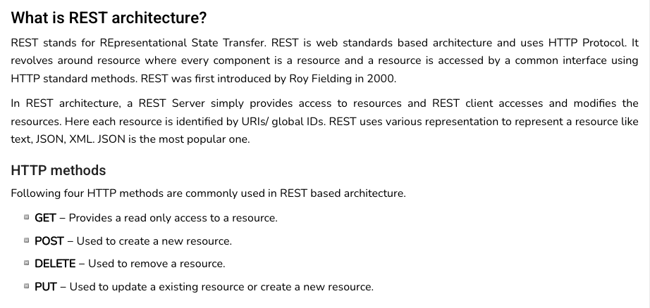
REST (https://www.tutorialspoint.com/restful/restful_introduction.htm)

Slide 66
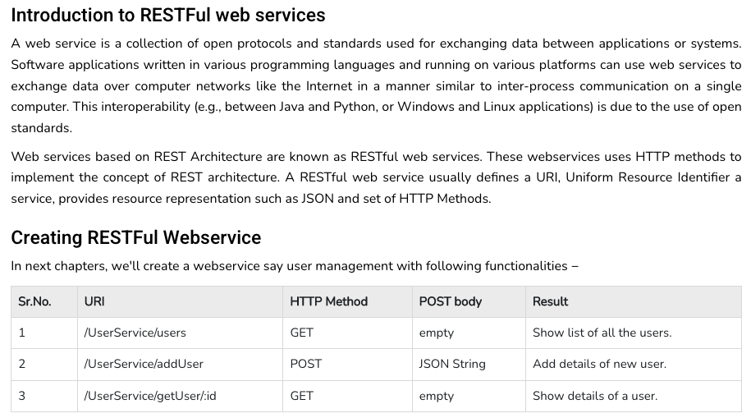
REST (https://www.tutorialspoint.com/restful/restful_introduction.htm)

Slide 67
REST and Resources

Slide 68
URLs

Slide 69
Walk Through the Project Template

Slide 70
Data Engineering

Slide 71
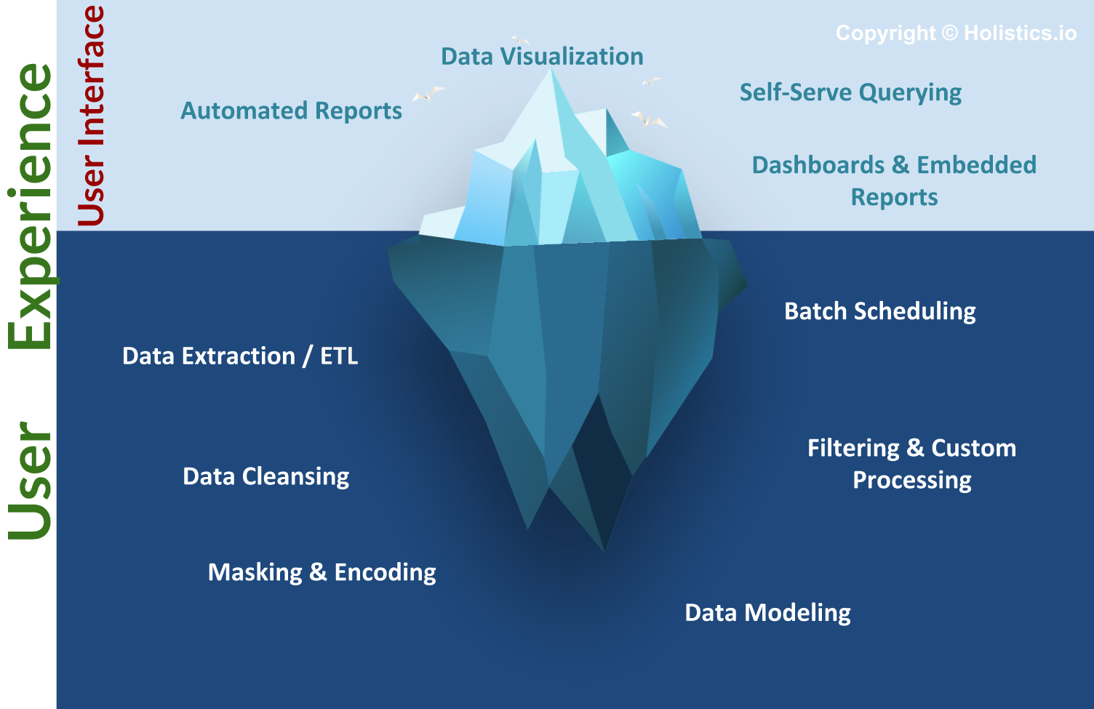
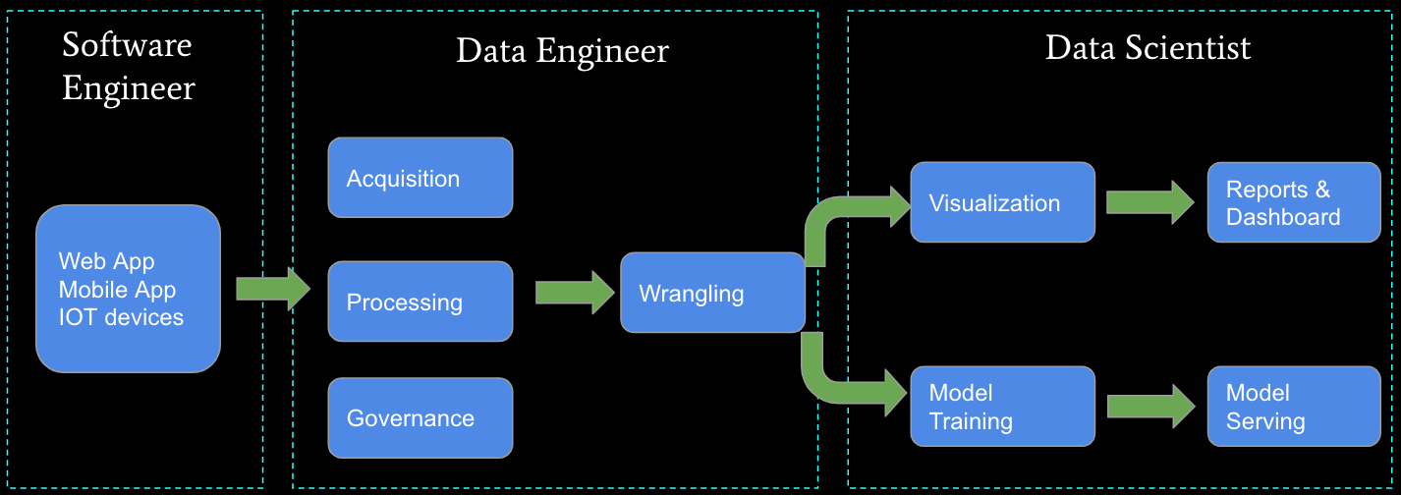
Business Intelligence, Insight, Analysis, … …
The “fun” stuff in data science and AI/ML is the “tip of the iceberg.”
Data engineering is a necessary condition for producing analyzable data. This is often more than 80% of the hard work.
We will do some small data engineering projects in this course.

Slide 72
Walk Through the Sprint 1 Notebook

